Slide 1


Luminara Learn
Illuminating the Path to Understanding.
Notes:
1

Slide 2


The Challenge
Students struggle when given answers without understanding the journey to discovery.
Notes:
2

Slide 3

Our Philosophy
We don't give answers. We light the way to discovery.
Notes:
3

Slide 4





Core Principles
Discovery Over Delivery
Logic Meets Reality
Focus on the journey of understanding, not just the answer.
Connect abstract concepts to real-world applications.
Personalized Pathways
Collaborative Learning Ecosystem
Tailor learning experiences to individual student needs.
Foster interaction between students, parents, and educators.
Notes:
4

Slide 5
Student Journey with Luminara Learn
Capture a problem with your device's camera.
Our AI identifies the core concepts involved.
Receive interactive guidance cards breaking down the problem.
Work through each step with personalized support.
Check your answer and receive detailed feedback.
Celebrate your success and deepen your understanding!
Notes:
5

Slide 6
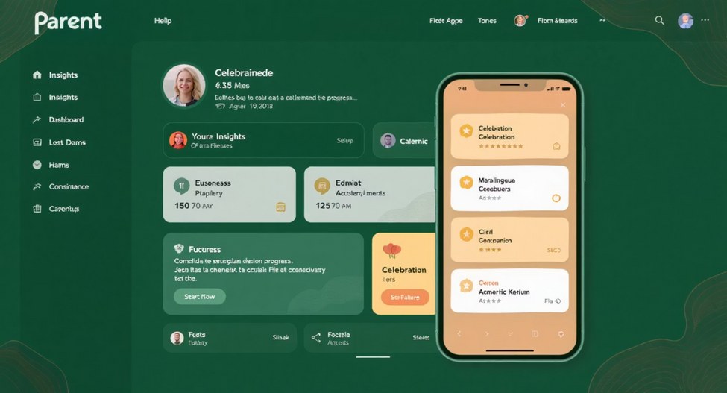
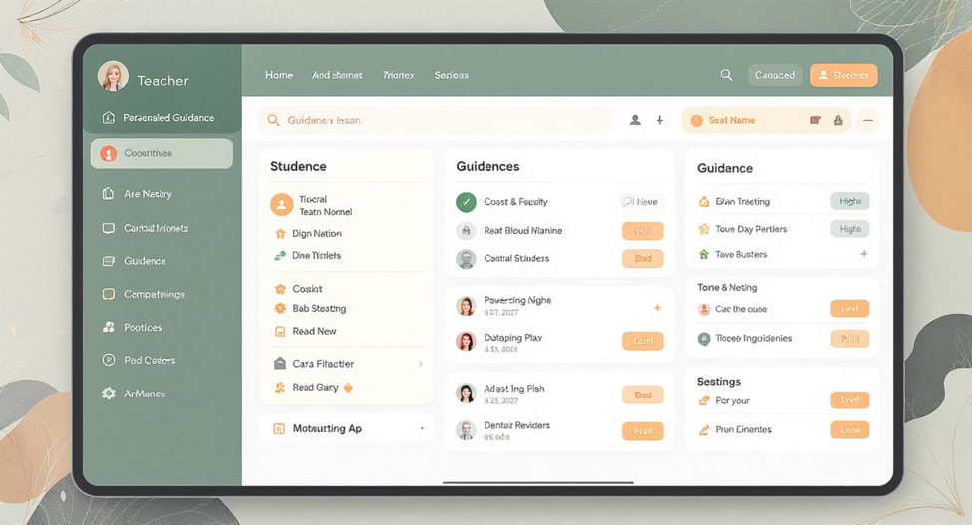
Parent & Educator Experiences
Parent Dashboard
Educator View
Track your child's progress and celebrate milestones.
Monitor student performance and provide customized support.
Notes:
6

Slide 7

Our Technology Advantage
Pedagogically Sound: Grounded in educational research and best practices.
Contextually Relevant: Adapts to the specific problem and student's level.
Emotionally Supportive: Encourages and motivates students throughout the learning process.
Appropriately Challenging: Provides the right level of difficulty to foster growth.
Notes:
7

Slide 8

The Luminara Difference
Traditional Learning Apps
Luminara Learn
Illuminating Potential: Fostering critical thinking and problem-solving skills.
Honoring the Process: Emphasizing the journey of discovery over just the final answer.
Connecting Communities: Building a supportive ecosystem for students, parents, and educators.
Notes:
8

Slide 9

A world where every student experiences the joy of discovery, where learning challenges become exciting puzzles to solve, and where families and educators work together to nurture confident, capable learners.
Notes:
9

Slide 10


Join the Journey of Discovery
Illuminate understanding. Transform education. One step at a time.
Notes:
10

